Slide 1
Avila Ranch Development Plan 173 Buckley Road/175 Venture Drive SPEC/ER-1318-2015
Public Hearing for the
Draft Environmental Impact Report (EIR)
December 14, 2016
Applicant: Avila Ranch, LLC
Representative: Stephen Peck

Slide 2
Purpose of Tonight’s Meeting
Overview of the Draft EIR for the Avila Ranch Development Plan
Review project impacts, mitigation measures, and alternatives
Public Comment on the Draft EIR findings and analysis to be considered and responded to in the Final EIR
No action or decisions will be made tonight

Slide 3
EIR Process Overview
NOP Comment Period/Scoping Process
Public Draft EIR Released
(45-day comment period)
Response to Comments & Final EIR Released
Final EIR Certification &
City Decision-maker Hearings

Slide 4
Project EIR Timeline
Winter 2016 – 2017
Public Review of Draft EIR
Spring 2017
Respond to Comments
Summer 2017
Final EIR & Certification

Slide 5
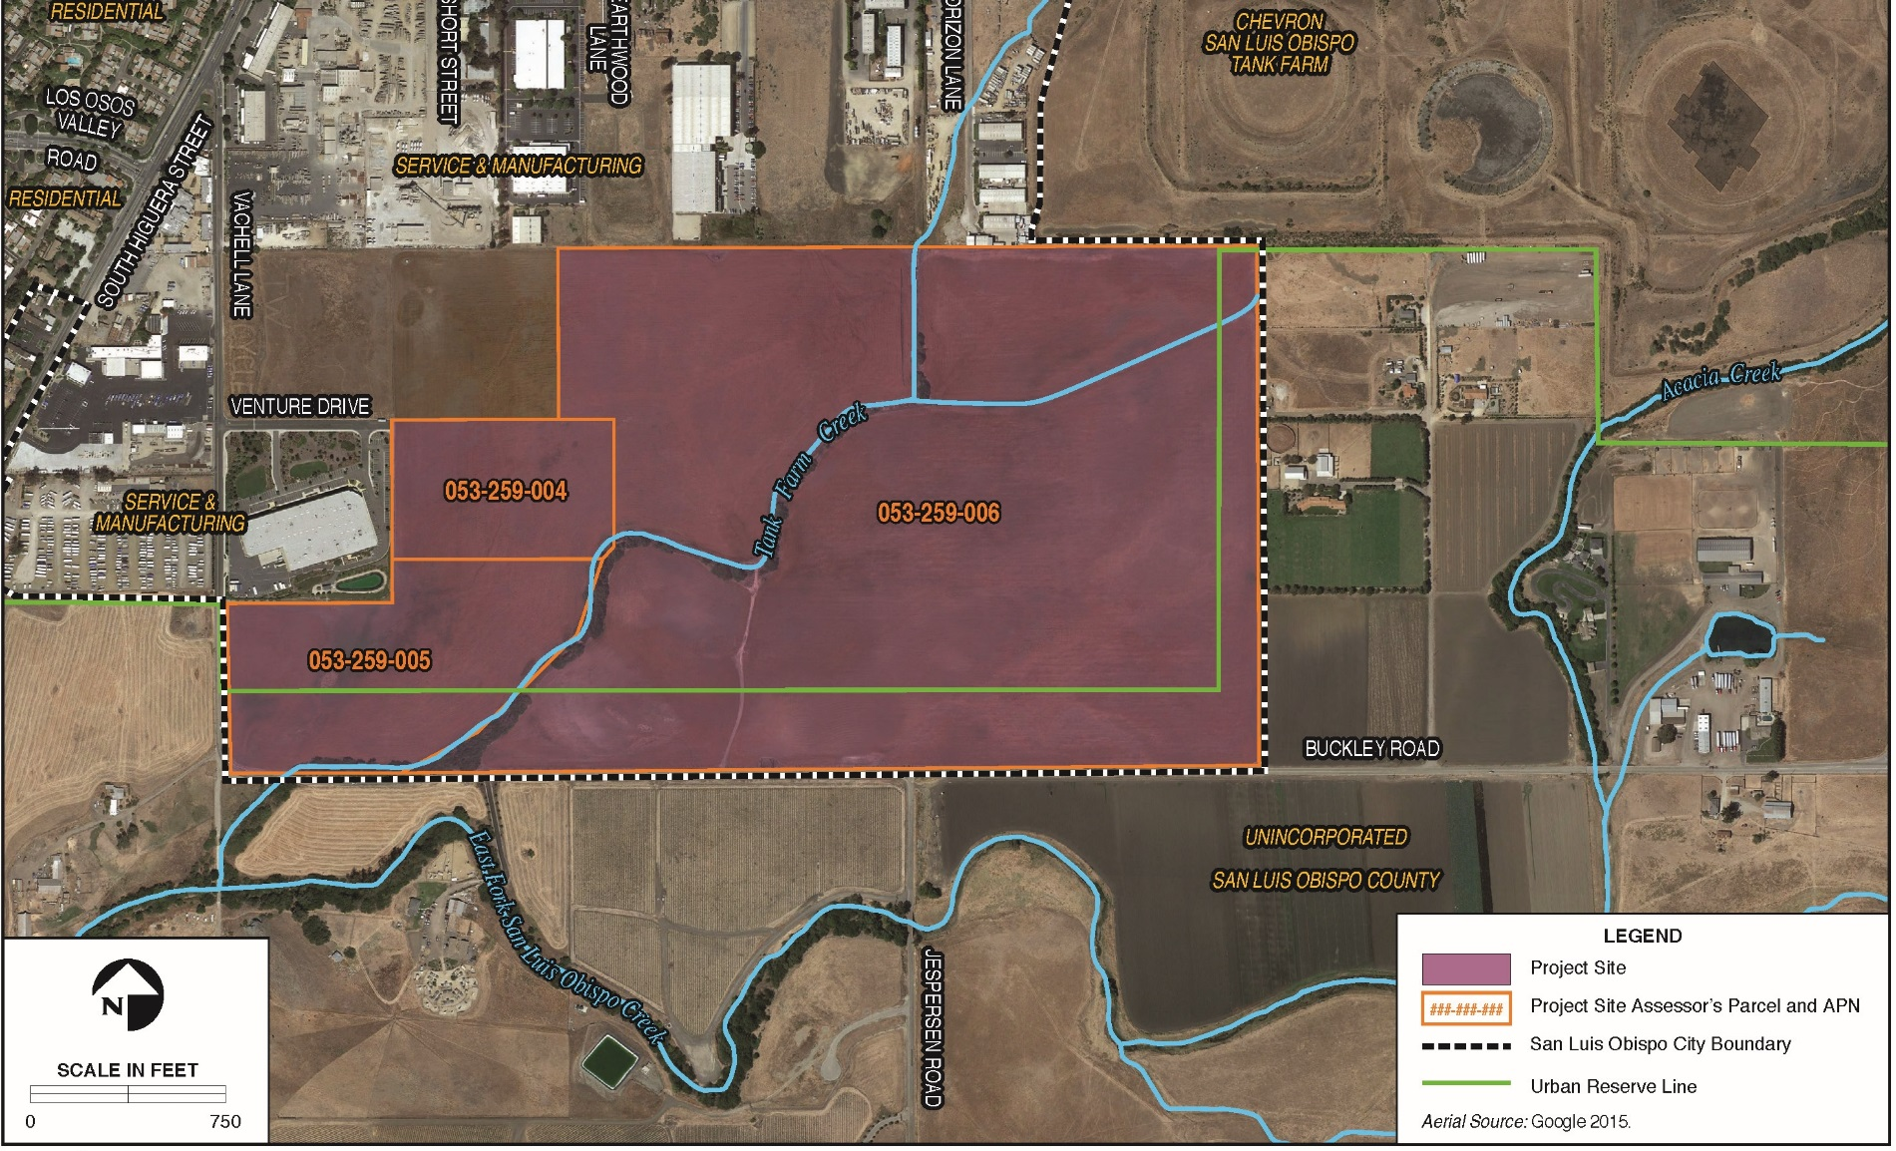
Project Site and Location

Slide 6
Project Description
Development Plan, Airport Area Specific Plan Amendment, and General Plan Amendment for the 150-acre project site
Development on the property may include:
Up to 720 low, medium, and higher density residences
15,000 square feet of commercial use
Roughly 50% of site would remain in open space & parks
Tank Farm Creek would be realigned and restored
Extension of Buckley Road, Venture Drive, and Horizon and Earthwood (Jespersen) Lanes
Development Plan will guide land use, design, circulation, and infrastructure

Slide 7
Summary of Proposed Land Uses
Land Use | Acreage | Housing Units/ Square Footage
Residential | 68.23 | 720 total units
R-1 Low Density | 17.45 | 105 single-family units
R-2 Medium Density | 35.03 | 305 single-family units
R-3 Medium-High Density | 11.04 | 185 multi-family units
R-4 High Density | 4.71 | 125 multi-family units
Neighborhood Commercial | 3.34 | 15,000 sf
Major Roadways | 7.03 | N/A
Open Space and Parks | 71.30 | N/A
Open Space | 55.30 | N/A
Parks | 16.00 | N/A

Slide 8
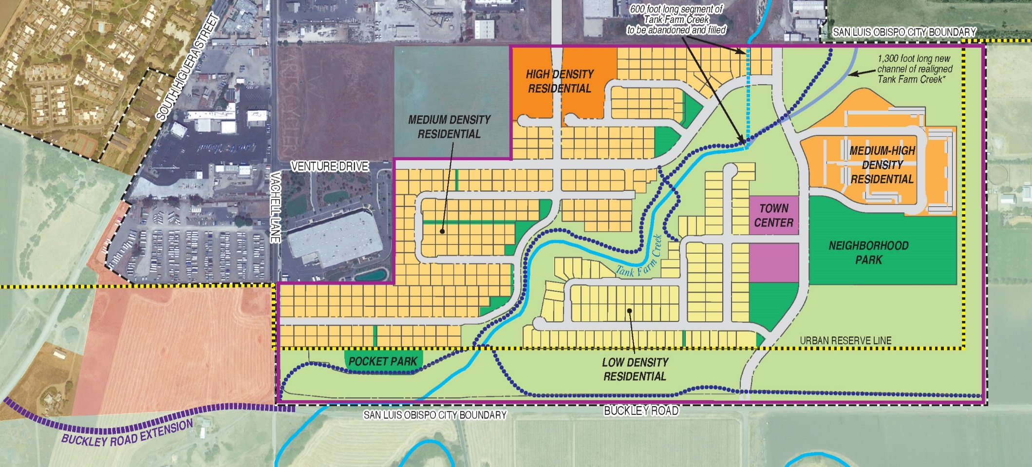
Proposed Land Use Plan

Slide 9
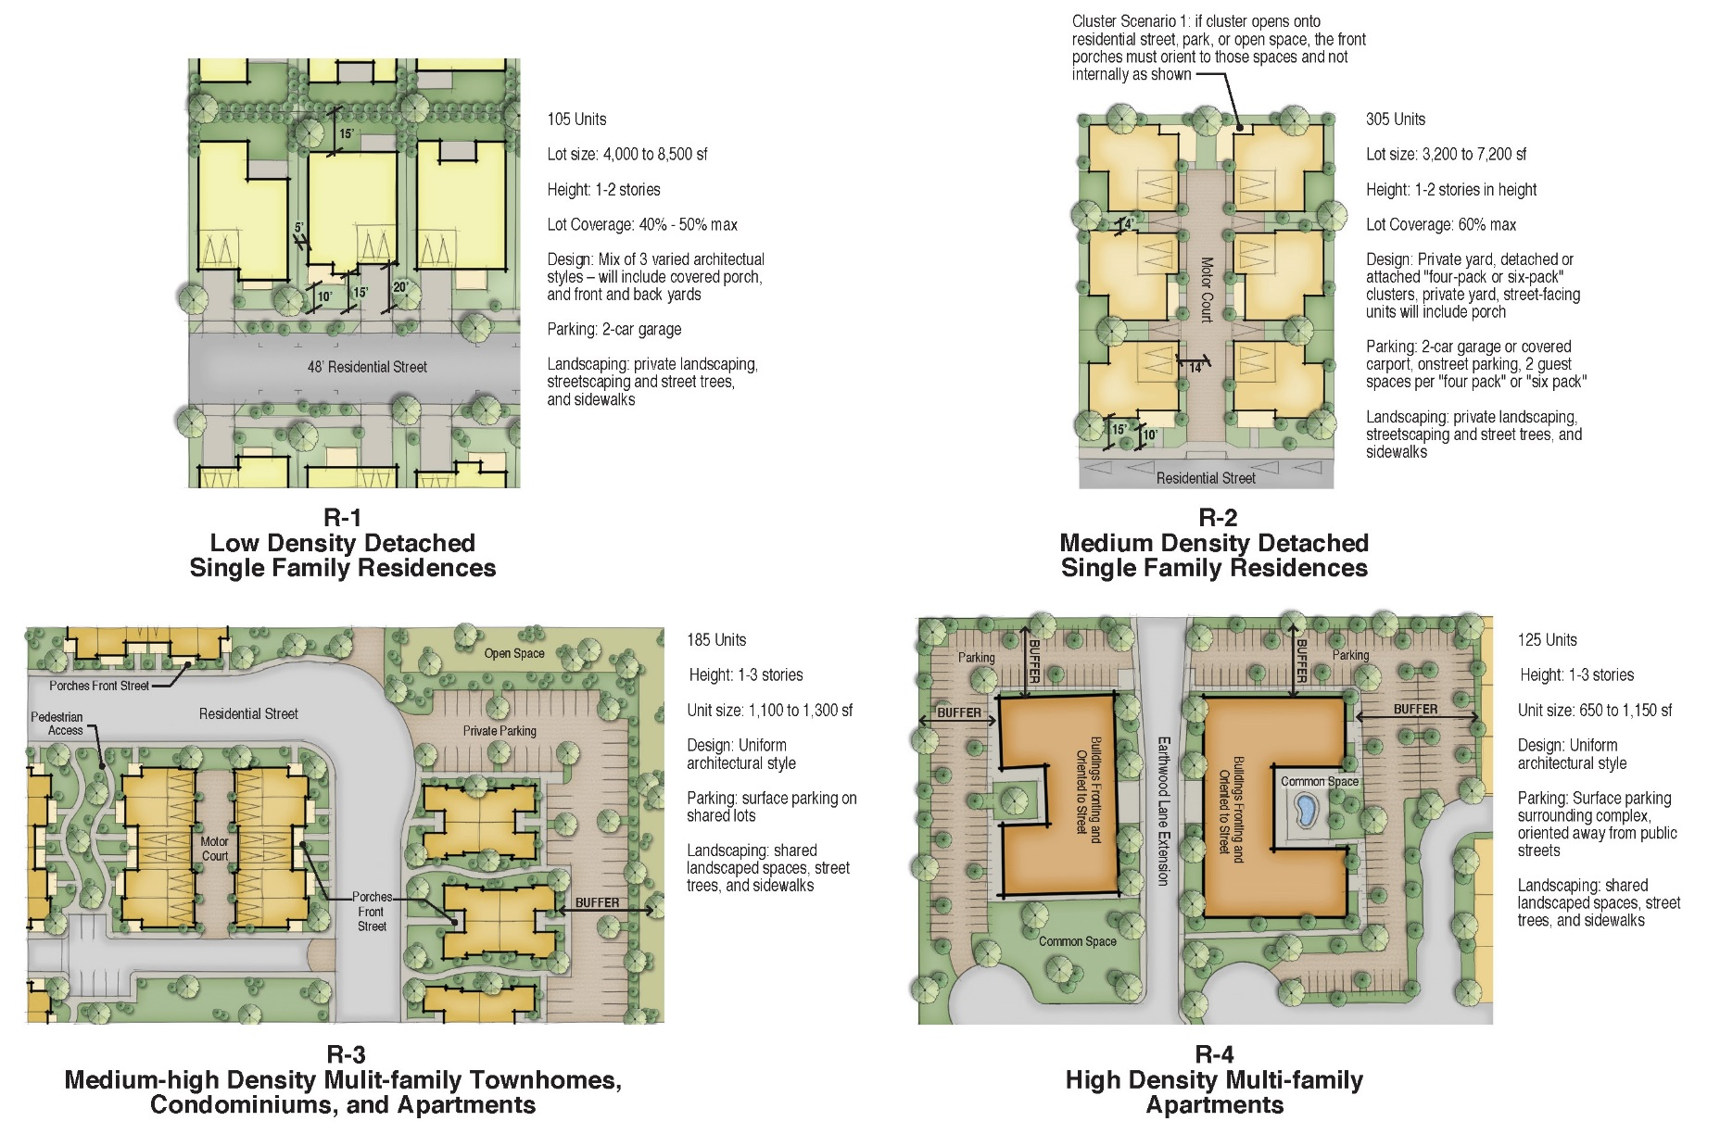
Proposed Residential Design Mix

Slide 10
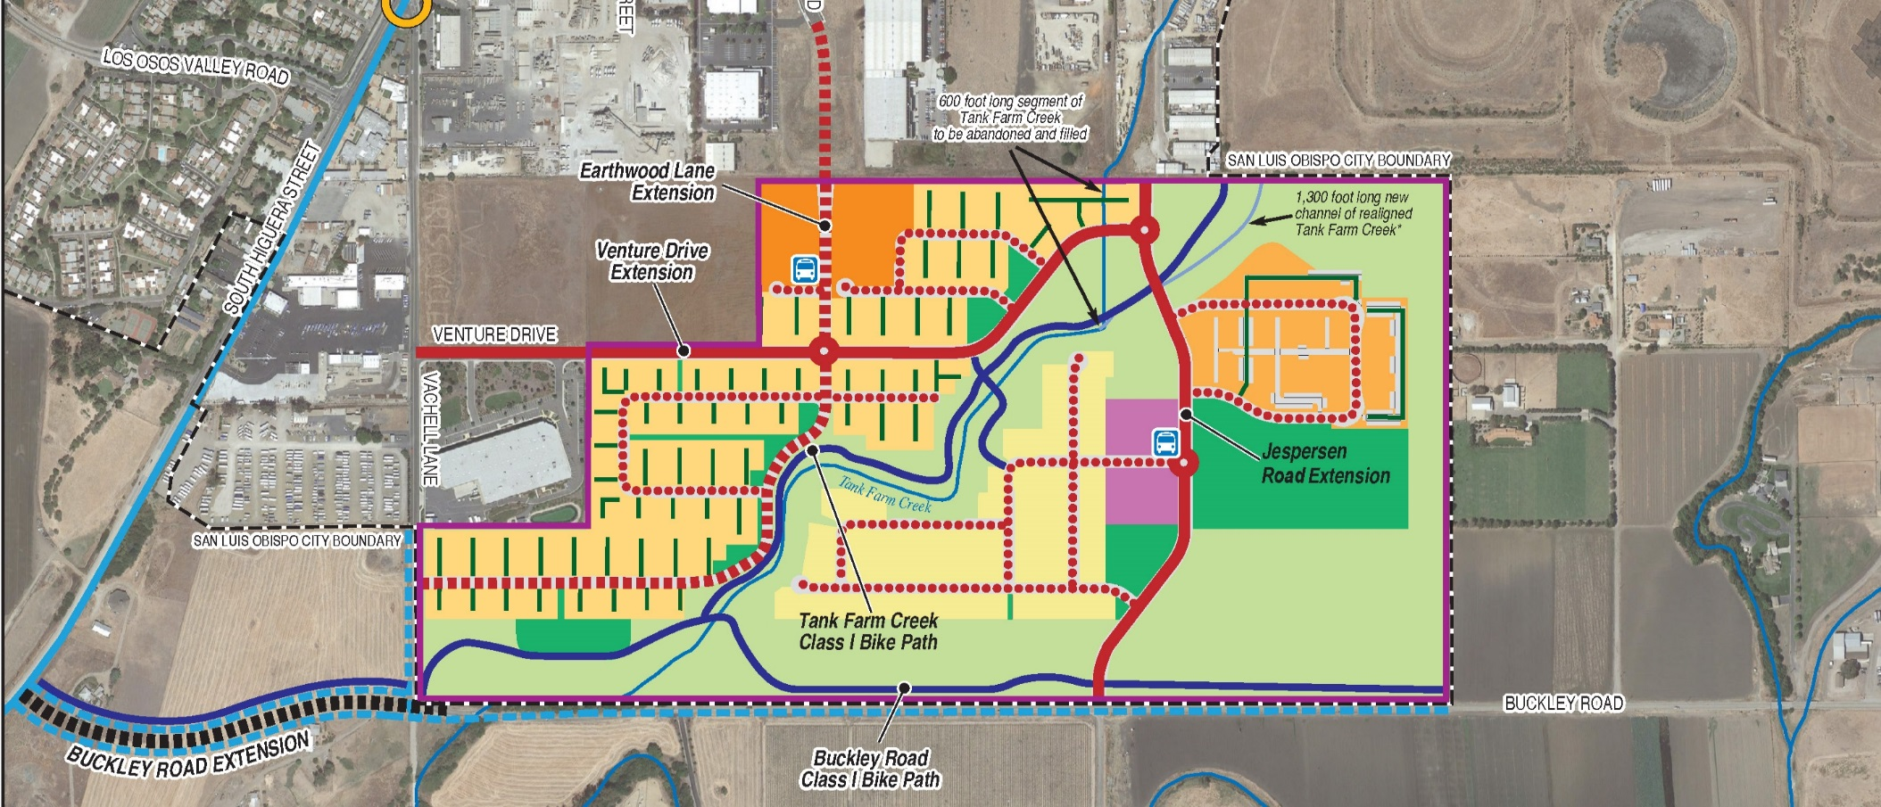
Proposed Circulation Plan

Slide 11
Example: Buckley Road Cross-Section

Slide 12
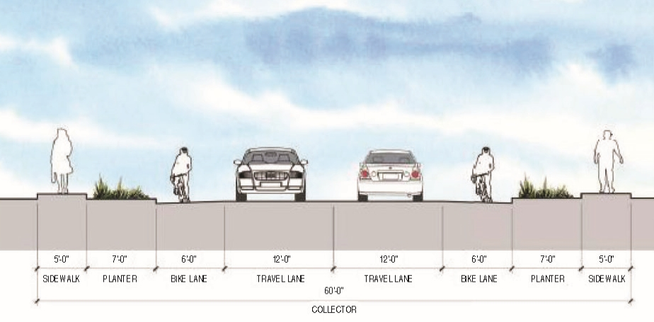
Example: 60’ Collector Road Cross-Section

Slide 13
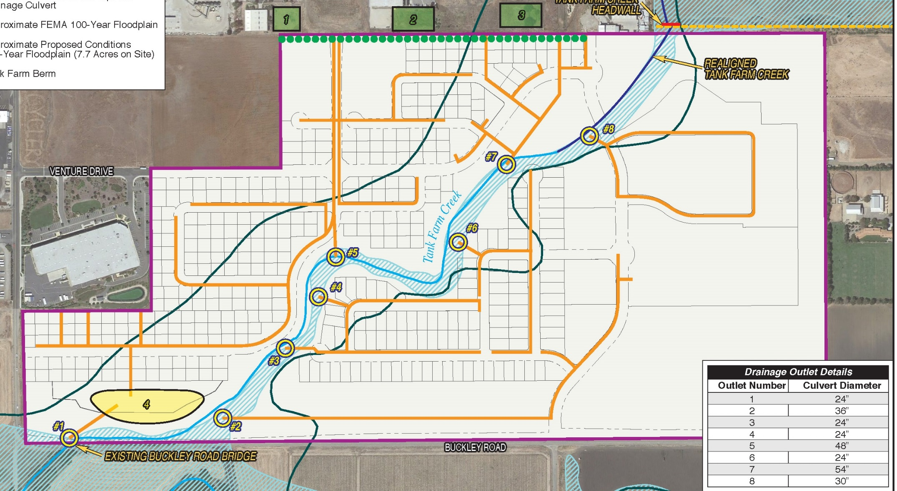
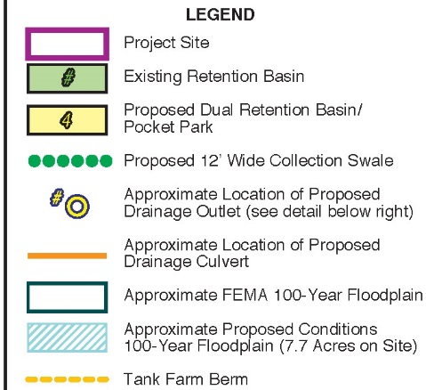
Proposed Drainage Plan

Slide 14
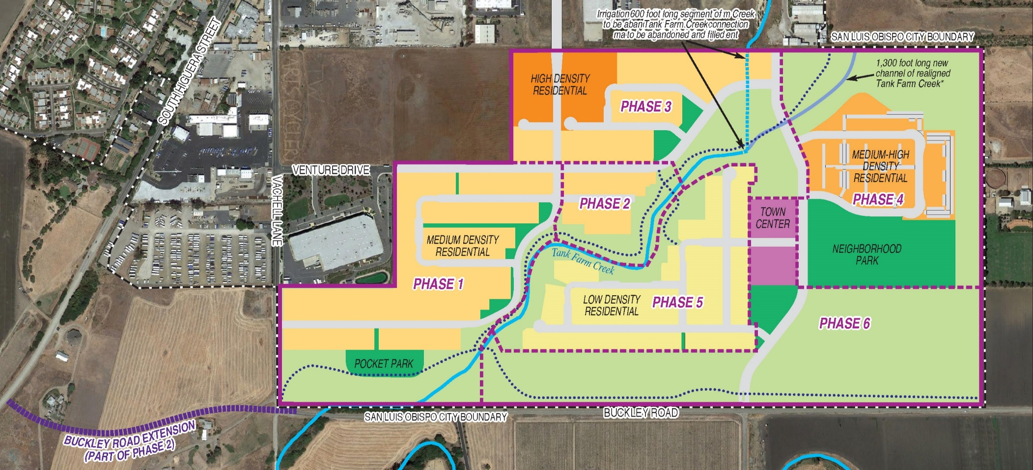
Development Plan: Phasing

Slide 15
CEQA Environmental Resources Analyzed in Draft EIR
Aesthetics & Visual Resources
Agricultural Resources
Air Quality & Greenhouse Gas Emissions
Biological Resources
Cultural Resources
Hazards & Hazardous Materials
Hydrology & Water Quality
Land Use & Planning
Noise
Population & Housing
Public Services
Transportation & Traffic
Utilities

Slide 16
Aesthetics & Visual Resources
Changes to scenic resources - loss of agriculture and mature trees
Change in visual character from rural to urban
Construction impacts to visual appearance over 10 year period
New source of night light and glare
Mitigation:
Develop landscape and open space buffer outside of the URL within Phase 1. Vegetation within the buffer would provide partial screening of ongoing construction.

Slide 17
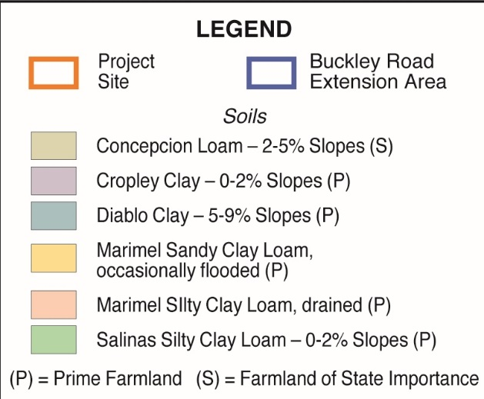
Agricultural Resources
Conversion of 68 acres of prime soils to urban development
Potential land use conflicts with adjacent agricultural operations
Mitigation:
Offsite agricultural conservation easement or pay in-lieu fees to preserve agricultural land
Install fencing and signs to minimize trespass and vandalism, and windrows to reduce potential for dust, noise, and pesticide drift.

Slide 18
Air Quality & Greenhouse Gas Emissions
Construction emissions would exceed APCD thresholds (ROG + NOx, PM2.5)
Operational emissions would exceed APCD thresholds (ROG + NOx, PM10, PM2.5)
Project would generate significant greenhouse gas emissions and would be potentially inconsistent with City’s Climate Action Plan and APCD’s Clean Air Plan
Potential land use conflicts with adjacent agricultural operations
Mitigation:
Construction Management Plan - control dust and emissions; low-VOC finishes; contribute to transit and trip reduction programs
Energy and water efficiency; implementation of mitigation from APCD CEQA Air Quality Handbook

Slide 19
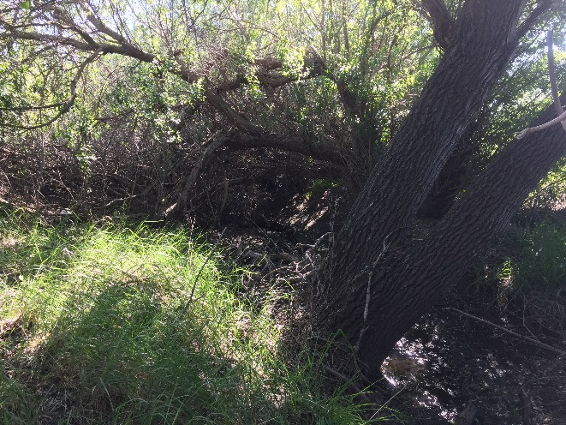
Biological Resources
Impacts to Tank Farm Creek, including wetlands and riparian areas
Impacts to wildlife and special status species
Mitigation:
Biological Mitigation Plan
Increased setbacks from Tank Farm Creek
Creek and wetland restoration
Avoid water contact, erosion, and runoff
Environmental monitoring and pre-construction surveys

Slide 20
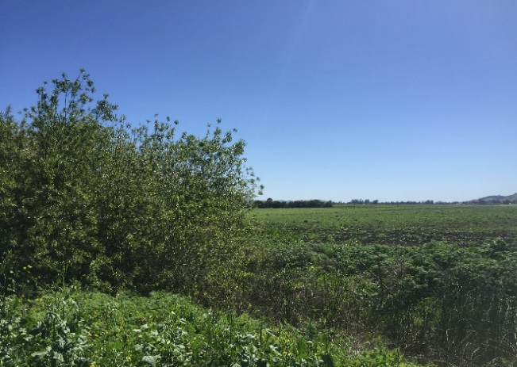
Hydrology & Water Quality
Water quality impacts to Tank Farm and San Luis Obispo Creeks
Site grading and development would alter drainage and affect flooding, erosion, and siltation
Increased possibility of flooding
Mitigation:
Stormwater Pollution Prevention Plan (SWPPP)
Master Drainage Plan and Maintenance Manual
Onsite drainage retention and treatment

Slide 21
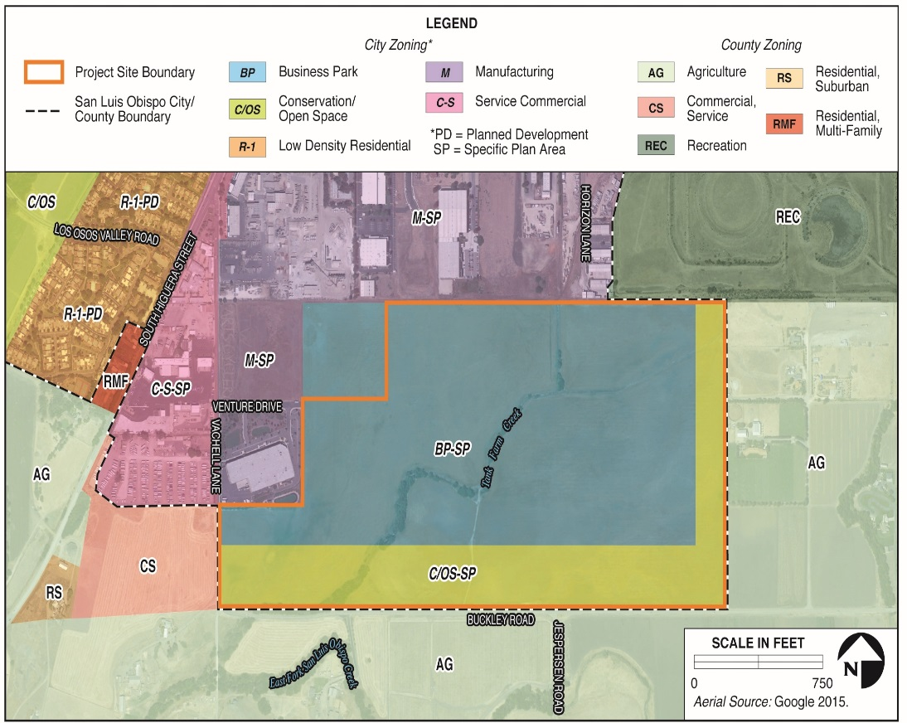
Land Use
Potential inconsistency with City policies for biological resources, agricultural resources, and utilities/public services
Project located within City Airport Overlay Zones and ALUP Safety Areas S-1B, S-1C, and S-2; consistent with both LUCE and ALUP

Slide 22
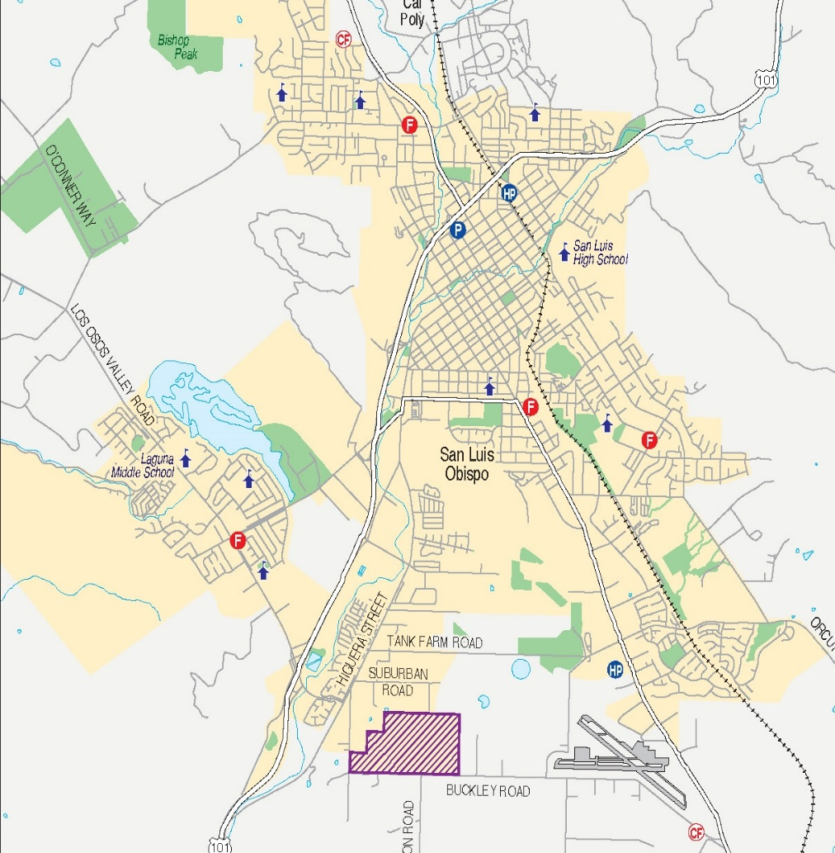
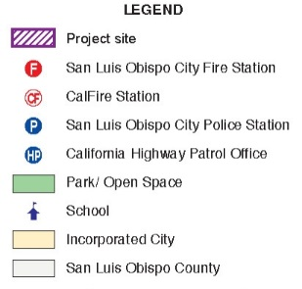
Public Services
Increased demand for law enforcement, fire protection, schools, and parks
Underserved area of City for fire services
Develop Interim Fire Station No. 5 as part of Phase 3
Mitigation:
Fair share contribution to fire station impact fee program

Slide 23
Transportation & Traffic
Project includes on and offsite transportation improvements
Operational impacts include:
Turning movement conflicts within Project site
Volumes at Vachell, Earthwood and Horizon Lanes; Suburban Road
Intersection LOS at Buckley Road/SR 227 and LOVR intersections;
Exacerbate queuing at Higuera Street and LOVR intersections per Circulation Element standards
Increased demand for bicycle and transit facilities and services
Mitigation (tied to phases):
Construction Traffic Management Plan
Transportation Improvement Phasing Plan
Fair share contribution to development impact fee program
Roadway improvements (e.g., turn lanes)
Multi-modal improvements and traffic calming measures
Bicycle bridges along Buckley Road over Tank Farm Creek

Slide 24
Additional EIR Issues
Cultural Resources
Adverse effects to historic features and prehistoric resources
Hazards & Hazardous Materials
Exposure to hazardous materials during construction
Airport hazards and safety
Wildfire hazards
Noise
Short-term and long-term significant increases in noise from construction and operational vehicle noise
Population & Housing
Beneficial effect on jobs/housing balance
Residential growth within annual growth rate and would provide affordable housing
Utilities
Increased demand for water supply, wastewater treatment, solid waste disposal, and energy

Slide 25
Alternatives Analysis
No Project Alternative
Continuation of agricultural uses, or
Development of Project site under City General Plan/LUCE
Mitigated Project Alternative
Similar residential and commercial development
Incorporation of key mitigation measures
No realignment of Tank Farm Creek
Residential Plus Business Park Land Use Alternative
700 units, 35,000 sf of neighborhood commercial space, and 120,000 sf of business park

Slide 26
Mitigated Project Alternative
5 features to reduce impacts
No realignment of Tank Farm Creek - protect riparian habitat
Retain East-West Channel - accommodate surface drainage
Different land use mix in Town Center - reduce trip generation
Increased development setbacks along Tank Farm Creek – protect biological resources

Slide 27
Mitigated Project Alternative
Inclusion of key offsite phased transportation improvements
Horizon Lane extension in Phase 4
Left turn restrictions at Vachell Lane/South Higuera Street in Phase 2
Temporary restrictions to vehicle site access from Venture Drive/Vachell Lane and Earthwood Lane during Phase 1
South Higuera Street/Suburban Road intersection improvements
Improvements to Horizon Lane as residential collector
Improvements to Suburban Road as commercial collector

Slide 28
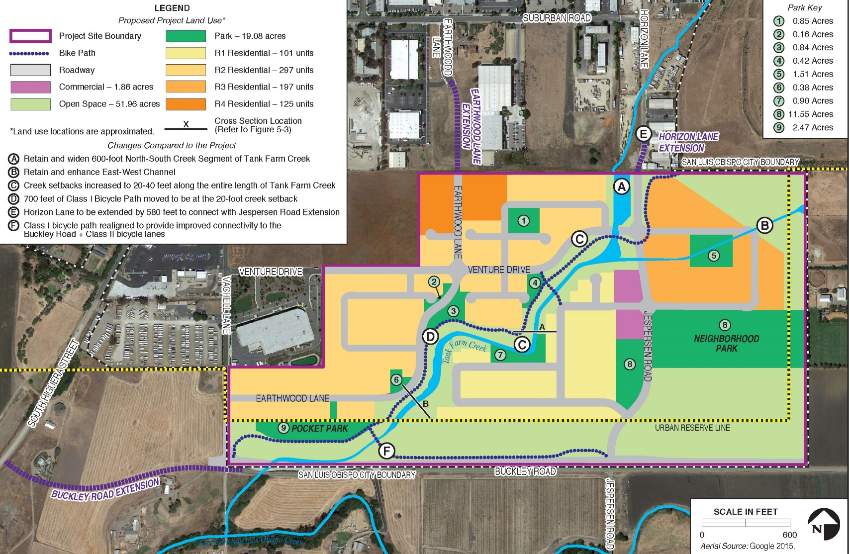
Mitigated Project Alternative

Slide 29
Comparison of Alternatives
Issue Area | No Project |  | Mitigated Project | Business Park
 | A. Vacant | B. General Plan
Aesthetics and Visual Resources | Less | Similar | Similar | Greater
Agricultural Resources | Less | Similar | Similar | Similar
Air Quality | Less | Similar | Similar | Greater
Biological Resources | Less | Similar | Less | Less
Cultural Resources | Less | Similar | Similar | Greater
Hazardous Materials | Less | Similar | Similar | Greater
Hydrology and Water Quality | Less | Less | Less | Less
Land Use and Planning | Less | Less | Less | Greater
Noise | Less | Similar | Similar | Greater
Population and Housing | Greater | Similar | Similar | Similar
Public Services | Less | Similar | Similar | Similar
Transportation and Traffic | Less | Similar | Less | Greater
Utilities | Less | Similar | Less | Greater
Project Objectives Met? | No | Partially | Yes | Yes

Slide 30
Next Steps
End of Draft EIR Public Review – January 18, 2017
Public Hearing Draft AASP and FEIR available
– end of April 2017
Planning Commission hearings – June 2017
City Council hearings – July 2017

Slide 31
Public Comment
Receive and consider public input
Consider questions and major issues
Provide direction to staff and consultant
Keep focused on EIR issues
Additional opportunities to comment on overall merits of project
Please send comments to:
John Rickenbach or Tyler Corey
City of San Luis Obispo
Community Development Department
919 Palm Street
San Luis Obispo, CA 93401-3218
Or email
JFRickenbach@aol.com
tcorey@slocity.org
COMMENTS DUE BY JANUARY 18, 2017

